Slide 1
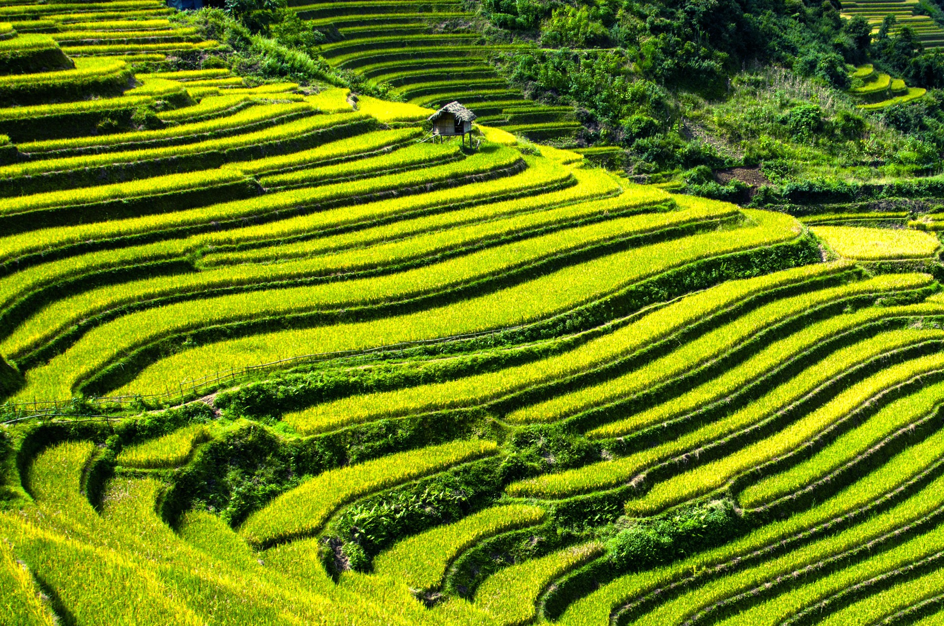

Time Series Crop Type Classification and Vegetation Monitoring using Sentinel 2 Spectral Bands Values
CS-540 ACPS PROJECT
GUIDED BY –
Dr. NEERAJ GOEL Sir
Dr. MUKESH SAINI Sir
PRESENTED BY –
SHUBHAM THAWAIT [2023CSM1015]
SRAVAN S SANKAR [2023CSM1014]
VAIBHAV BARSAIYAN [2023CSM1019]

Slide 2
CS-540 ACPS PROJECT
CHECKPOINT—1

Slide 3
PROBLEM STATEMENT
Implementing and evaluating deep learning models for crop type mapping using the Satellite Time series [TimeSen2Crop] dataset.
Finally Compare the Accuracy given by different models on the same Dataset.

Slide 4
EXPLAINATION
TimeSen2Crop is a pixel-based dataset comprising over 1 million samples of Sentinel 2 time series associated with 16 crop types.
Research in the supervised classification of Sentinel 2 time series for crop type mapping [The time series: September 2017 to August 2018].

Slide 5
EXPLAINATION
3) Covers atmospherically corrected images and provides information on snow, shadows, and clouds for each labeled unit.
4) TimeSen2Crop also contains Sentinel 2 images from the subsequent agronomic year (September 2018 to August 2019), aiming to attract research for adapting deep learning models to different years (domain adaptation).

Slide 6
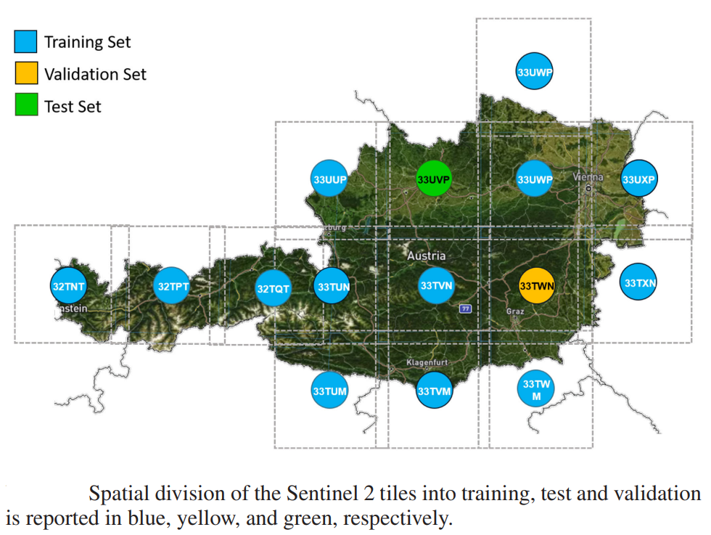

Slide 7
IN THE CONTEXT OF THE ARTICLE
1) THE TERM "TILES" REFERS TO THE GEOGRAPHICAL DIVISION OF THE AUSTRIAN COUNTRY INTO SMALLER UNITS, EACH COVERED BY A SENTINEL 2 SATELLITE IMAGE.
2) GEOGRAPHICAL COVERAGE: The Austrian country is covered by 15 Sentinel 2 tiles. These tiles represent specific geographic regions within Austria.

Slide 8
IN THE CONTEXT OF THE ARTICLE
3) TRAINING, TEST, AND VALIDATION SETS: Samples extracted from these tiles are used to create three sets: the training set, the test set, and the validation set. These sets are statistically independent of each other.
4) PURPOSE: Analyze time series data, such as sequences of Sentinel-2 images captured over the course of an agricultural year. By leveraging deep learning techniques.

Slide 9
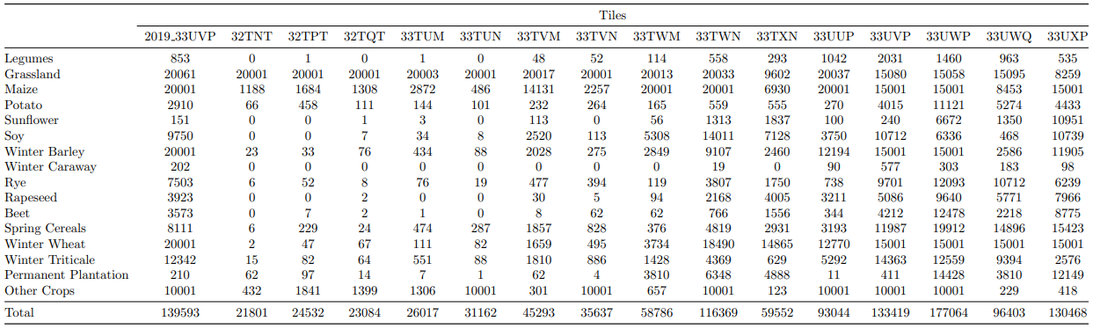
DESCRIPTION OF DATASET
The following table summarizes the number of training samples available for each tile and each crop type

Slide 10
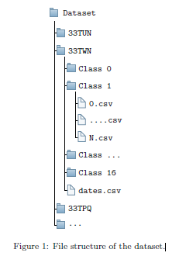
DESCRIPTION OF DIRECTORY STRUCTURE OF Available DATASET
Dataset organized hierarchically by Sentinel 2 tiles, with 16 folders (15 for tiles and one for 2019).
Each Sentinel 2 folder contains 16 sub-folders for different crop types.
Includes a CSV file with acquisition dates ordered chronologically for samples in each tile.
Crop-type sub-folders store labeled samples in CSV files with multispectral temporal signatures.
CSV files contain matrices where rows represent acquisition dates and columns represent spectral bands.
Spectral bands include blue (B2), green (B3), red (B4), four vegetation red edges (B5, B6, B7, B8A), and two short wave infrared (SWIR) (B11, B12). And Clear (0), cloud (1), shadow (2), or snow (3).

Slide 11
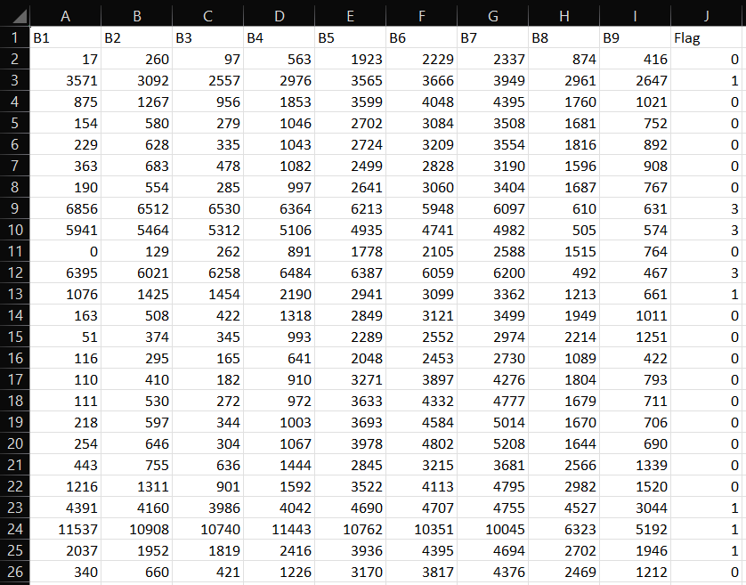
PIXEL CSV FILE DEMO --

Slide 12
WHICH MODEL WE ARE IMPLEMENTING?
Three Models we are going to implement in our project –
Time-based Convolution Model
Attention-based Model
Recurrence–based Model
1] Under the Time-based Convolution Model, we are using the TempCNN concept for the final implementation
2] Under the Attention-based Model, we are using the Transformer concept for the final implementation
3] Under Recurrence–based Model, we are using the LSTM concept for the final implementation

Slide 13
INFORMATION
Problem: Time Series Crop Type Classification using Sent-2 Spectral Values.
Description: Implementing a Transformer-based model to classify crop types based on Sentinel 2 spectral bands data.
Model using : Attention-based Model

Slide 14
CS-540 ACPS PROJECT
CHECKPOINT—2

Slide 15
Progress Updated : 27th March 2024
Out of the given huge dataset, we picked a single pixel CSV file that corresponds to the 2019 agronomic data of tile numbered 2019_33UVP.
Under this tile, we selected a Legume named crop type which is coded as “0” in the dataset regarding only one single pixel on behalf of different dates on which data is available.

Slide 16
DATA LOADING AND PREPROCESSING
Loads a CSV file containing spectral bands and labels into a Pandas DataFrame.
Splits the dataset into features (spectral bands) and labels (flags).
Splits the dataset into training and validation sets using the train_test_split function.
Normalizes the features (spectral bands) using StandardScaler from scikit-learn.

Slide 17
MODEL BUILDING
Defines a Transformer-based model architecture using Keras Functional API.
The model consists of MultiHeadAttention layers followed by LayerNormalization and Dropout layers.
GlobalAveragePooling1D layer is used to pool the features followed by a Dense layer with a sigmoid activation function for binary classification.

Slide 18
MODEL COMPILATION AND TRAINING
Compiles the model using the Adam optimizer with a learning rate of 1e-4, binary crossentropy loss function, and accuracy as the evaluation metric.
Trains the model on the training set using the fit method, specifying the validation data, number of epochs, and batch size.

Slide 19
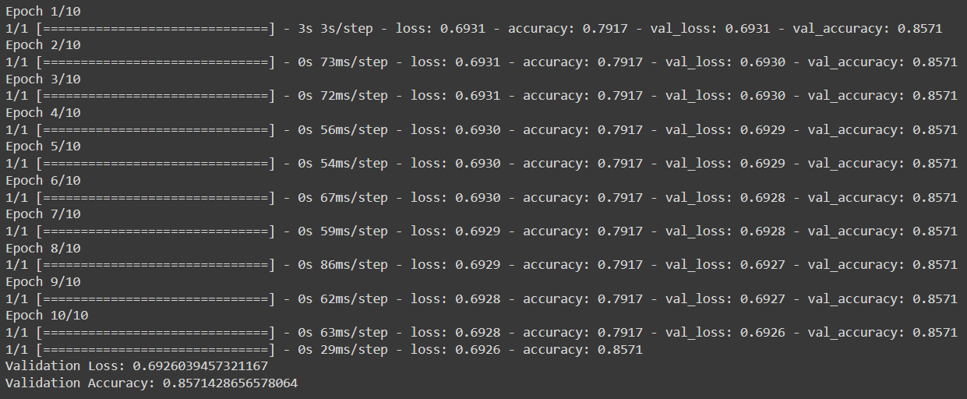
VALIDATION LOSS & VALIDATION ACCURACY

Slide 20
MODEL EVALUATION:
Evaluates the trained model on the validation set using the evaluate method, calculating the loss and accuracy.

Slide 21
VISUALIZATION
Generates various plots to visualize the data distribution and relationships using Matplotlib and Seaborn: Histogram, Scatter Plot, Box Plot, Bar Plot, Correlation Heatmap, Pair Plot, Violin Plot, and Line Plot.

Slide 22
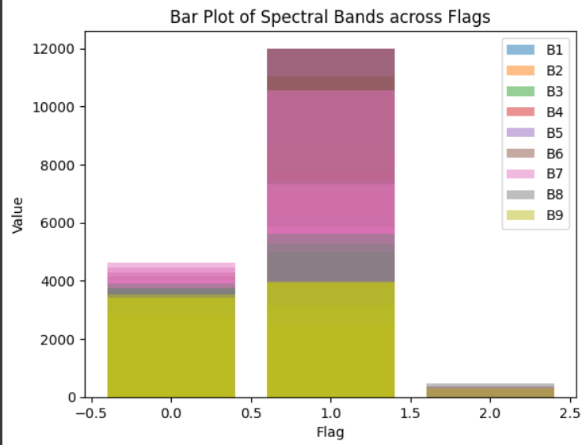
VISUALIZATION
-Bar Plot for Spectral Bands Across Flags:
Shows average values or distribution of each spectral band across different categories represented by flags.
-Interpretation:
Each spectral band has bars representing its average value across different flag categories, providing insights into how spectral bands vary across different conditions or classes.

Slide 23
TERMINOLOGIES
The "new unseen dataset" refers to a portion of the original dataset that the model has not been exposed to during the training phase. It is kept separate specifically for validation purposes.
1. New Dataset: It refers to a subset of the original dataset that the model hasn't encountered before during training. This ensures that the model's performance is evaluated on data that it hasn't learned from.
2. Unseen Data: This dataset contains samples that the model hasn't seen during the training phase. It's crucial to use unseen data for validation to accurately assess the model's ability to generalize to new examples.
In summary, the "new unseen dataset" serves as a crucial component in the validation process, enabling us to evaluate the model's performance on data that it hasn't encountered before, thereby providing insights into its ability to generalize to real-world scenarios.

Slide 24
CONCLUSION
1. TRAINING THE MODEL:
We train the model using a portion of the dataset called the training set.
During training, the model learns to associate the input spectral bands (features) with the corresponding crop types (labels).
2. VALIDATING THE MODEL:
After training, we should make sure that model performs well on new, unseen data.
For this , we set aside another portion of the dataset called the validation set.
3. USING THE VALIDATION SET:
We feed the validation set (consisting of spectral bands and their corresponding labels) into the trained model.
The model makes predictions for the crop types based on the input spectral bands.

Slide 25
CONCLUSION
4. ASSESSING PERFORMANCE:
We compare the model's predictions with the true labels in the validation set.
This comparison allows us to evaluate how accurately the model can classify crop types it hasn't seen before.
We measure the performance using two metrics:
Loss: A measure of how well the model's predictions match the actual labels. Lower loss indicates better performance.
Accuracy: The proportion of correct predictions made by the model. Higher accuracy indicates better performance.
5. INTERPRETING RESULTS:
A low validation loss and high validation accuracy indicate that the model is performing well on unseen data.
Conversely, a high validation loss or low validation accuracy suggests that the model may not generalize well to new data.
In essence, by validating the model on the validation set, we ensure that it can effectively classify crop types in new scenarios, beyond the data it was trained on. This step is crucial for assessing the model's real-world applicability and performance.

Slide 26
CS-540 ACPS PROJECT
CHECKPOINT—3

Slide 27
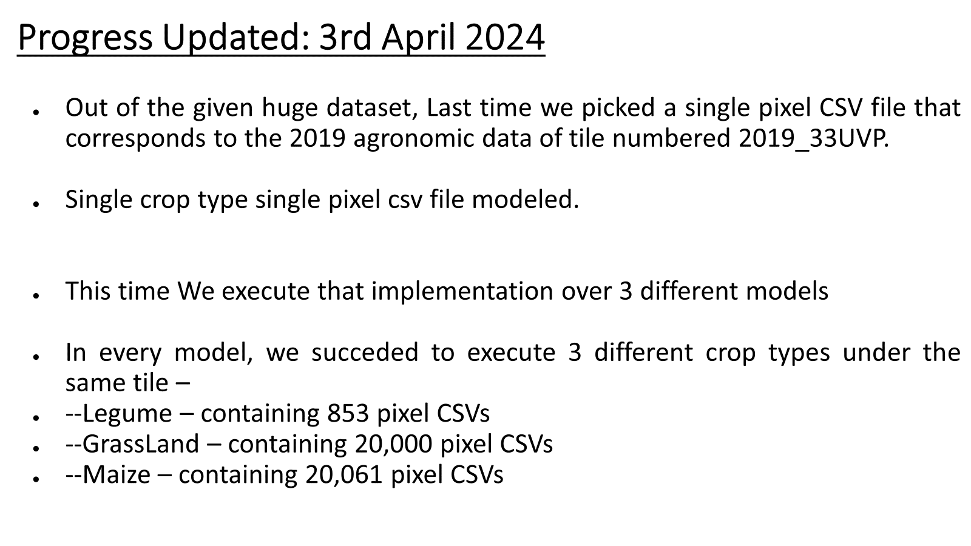

Slide 28
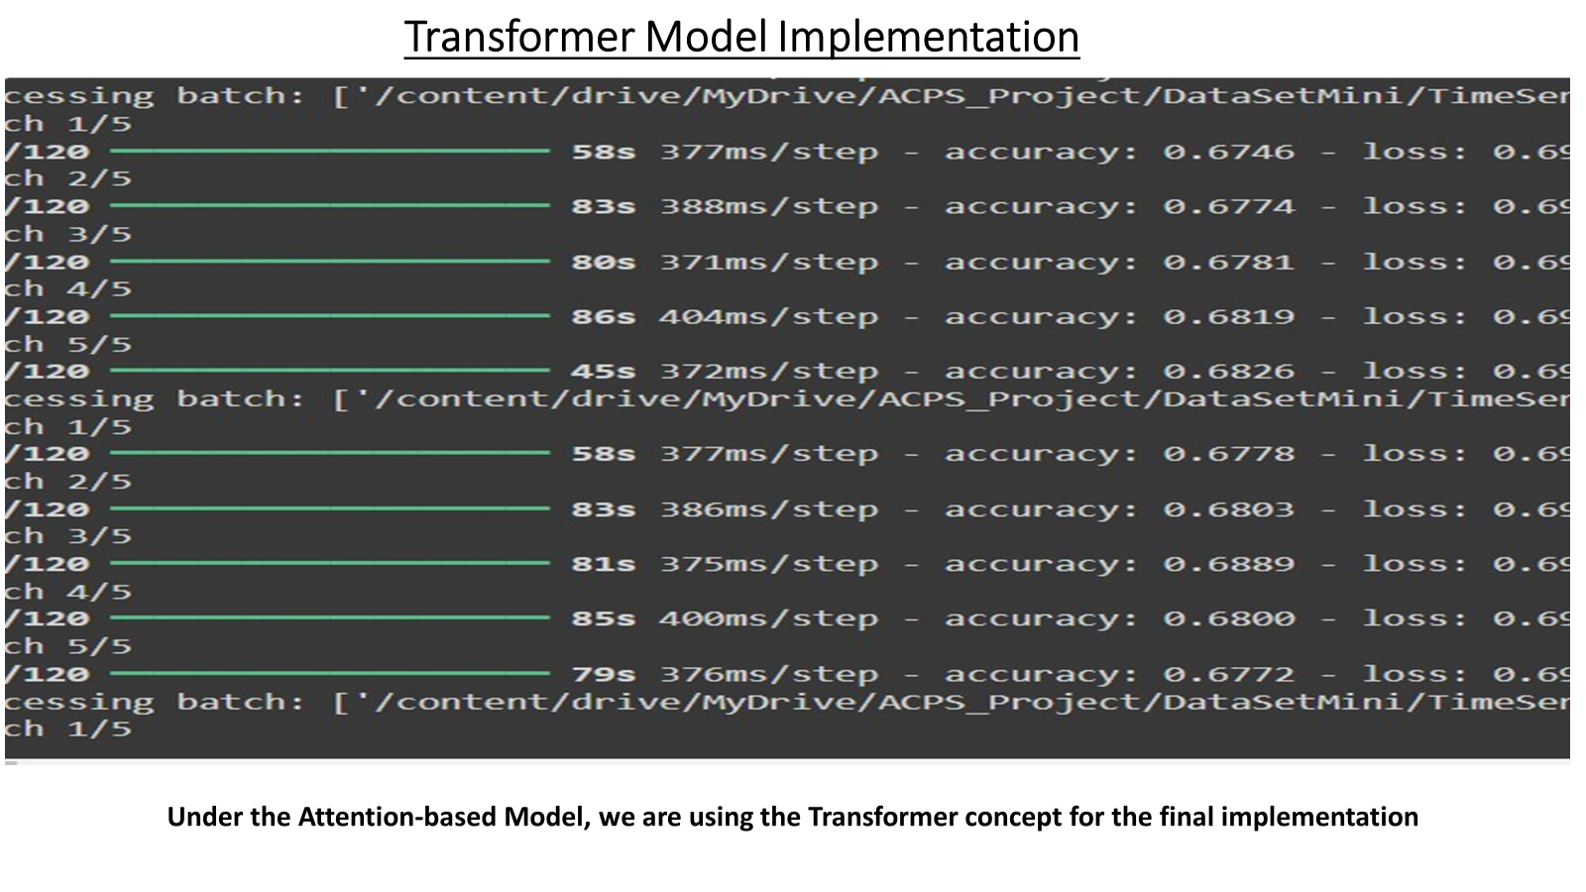

Slide 29
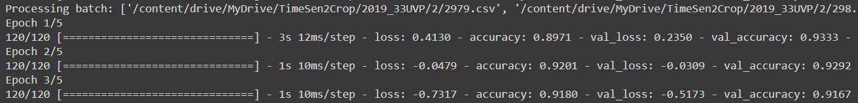
Temporal CNN model
Temporal CNN (Convolutional Neural Network) is a variation of traditional CNNs that specifically deals with sequential or temporal data, such as time series or video data. Unlike spatial CNNs, which analyze spatial relationships in images, temporal CNNs focus on capturing temporal dependencies within sequences of data.
So , we implemented this model into our dataset and we get this result

Slide 30
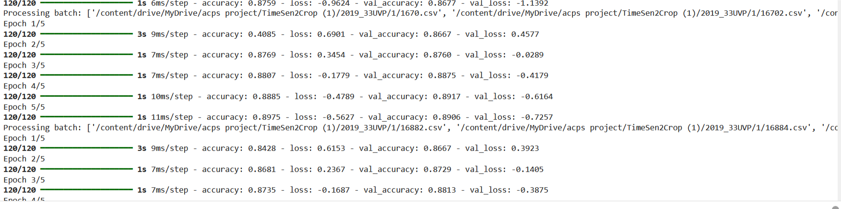
LSTM:
LSTM Model also using the same parameters and also the accuracy
The same dataset folder is which is used in the previous models

Slide 31
CS-540 ACPS PROJECT
CHECKPOINT—4

Slide 32
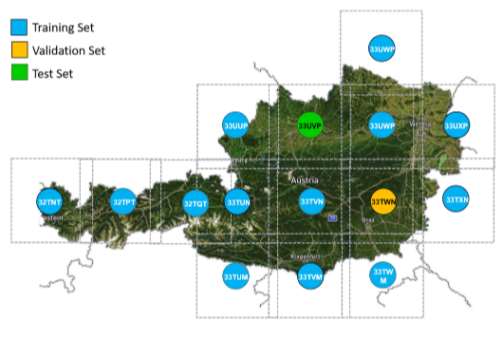
Progress Updated : 10 April
Dataset is re-organised into crop based folders from tile based.
Then model accuracy is compared for each crop type.

Slide 33
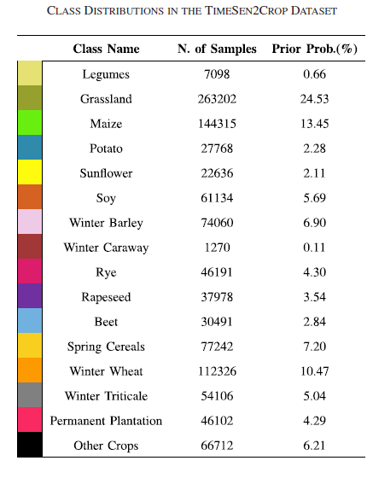
Progress Updated:10 April

Slide 34
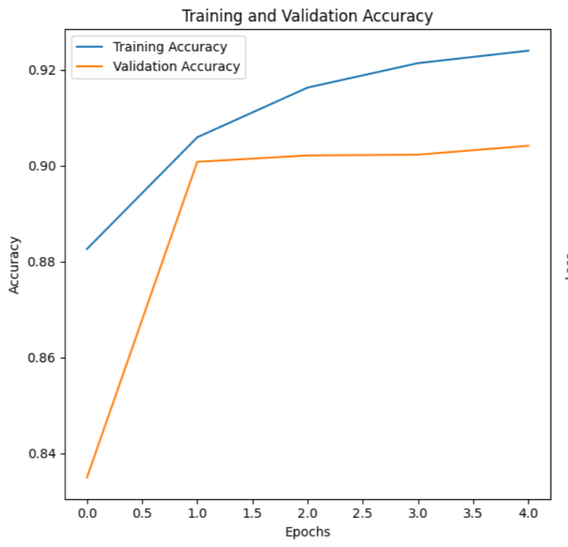
Legume (Croptype #0) Performance Analysis-LSTM : Accuracy

Slide 35
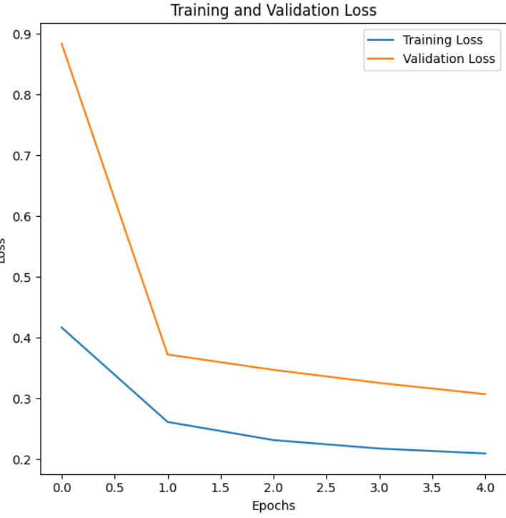
Legume (Croptype #0) Performance Analysis-LSTM : Loss

Slide 36

Legume (Croptype #0) Performance Analysis-LSTM :
Accuracy & Loss

Slide 37
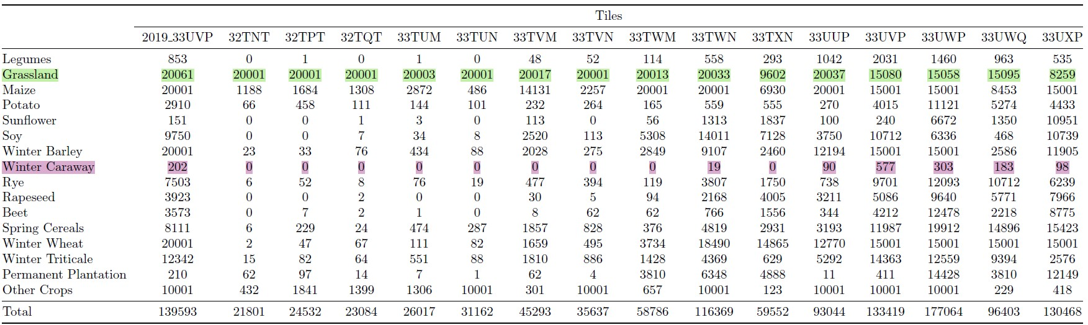
Observations –

Slide 38
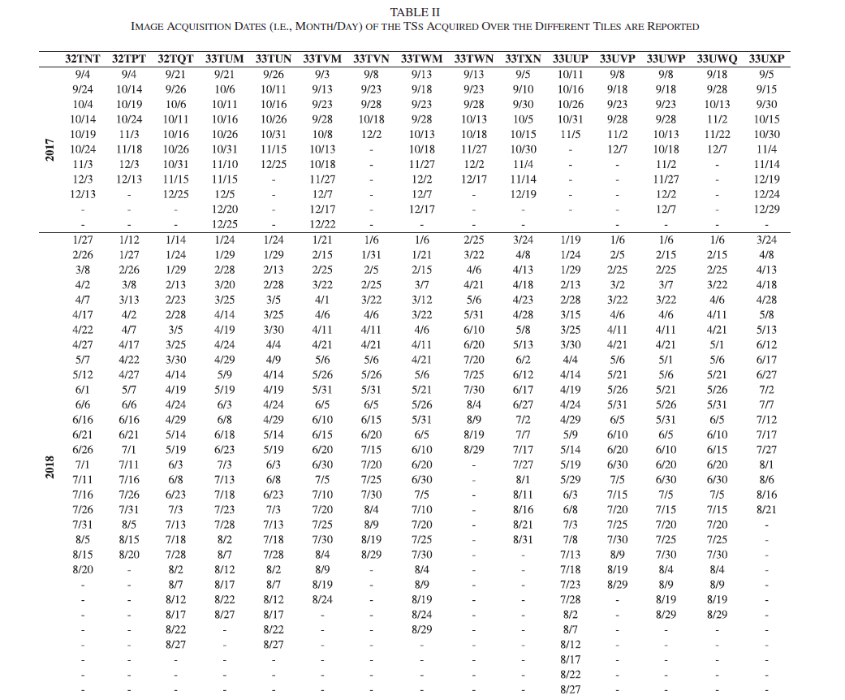
Observations –

Slide 39
UpComing Next Checkpoint:
Completing all crop type training,validation and testing using at least one Model completely out of the selected 3 models to be implemented.
Using the model which performs well,we will use that model to do the boundary classification tasks where multiple crops will be present.

Slide 40
CS-540 ACPS PROJECT
CHECKPOINT—5

Slide 41
Progress Updated : 17 April
Complete huge Dataset is again Re-organised into crop based folders from tile based folders
And inside every crop based folder, 3 folders being created namely- test, train, valid.
Each folder have country’s dedicated tiles complete data (all pixel csv files) regarding that croptype according to the research paper.

Slide 42
Progress Updated : 17 April
All 3 models being executed over the complete dataset.
Croptype wise Accuracy for test set and Validation set as well as Croptype wise Loss for test set and Validation set being plotted comparatively.

Slide 43
RESULTS (part–1)

Slide 44
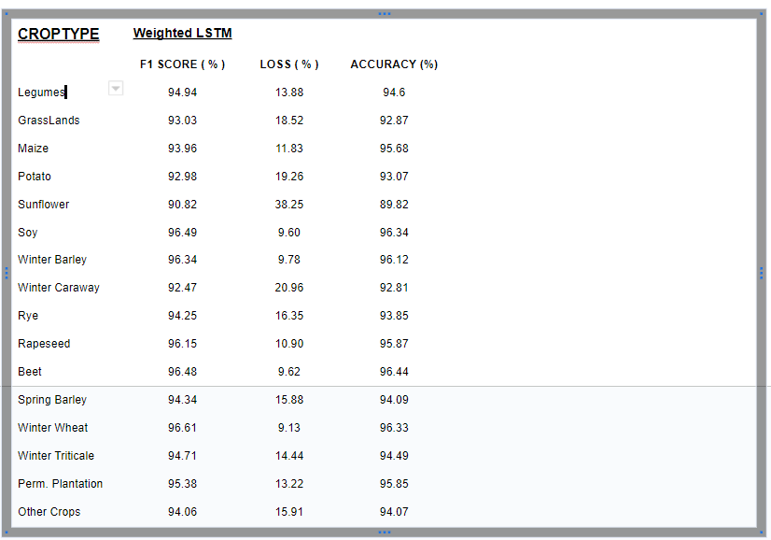

Slide 45
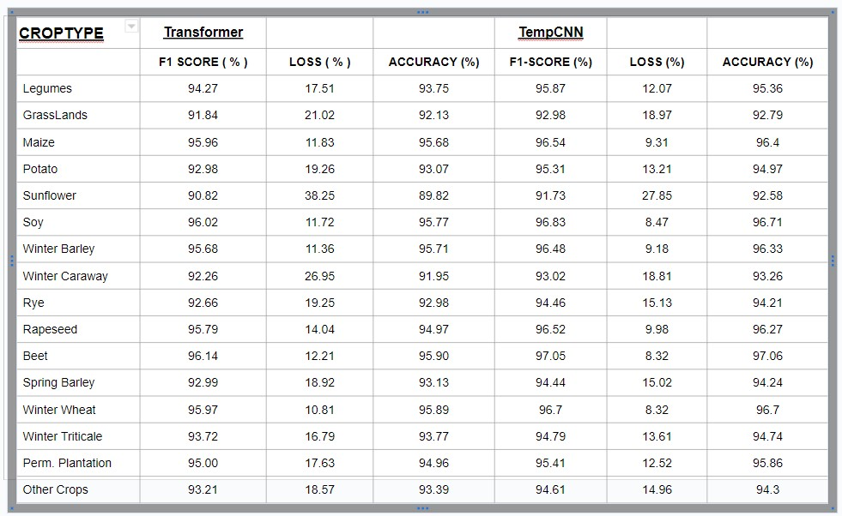

Slide 46
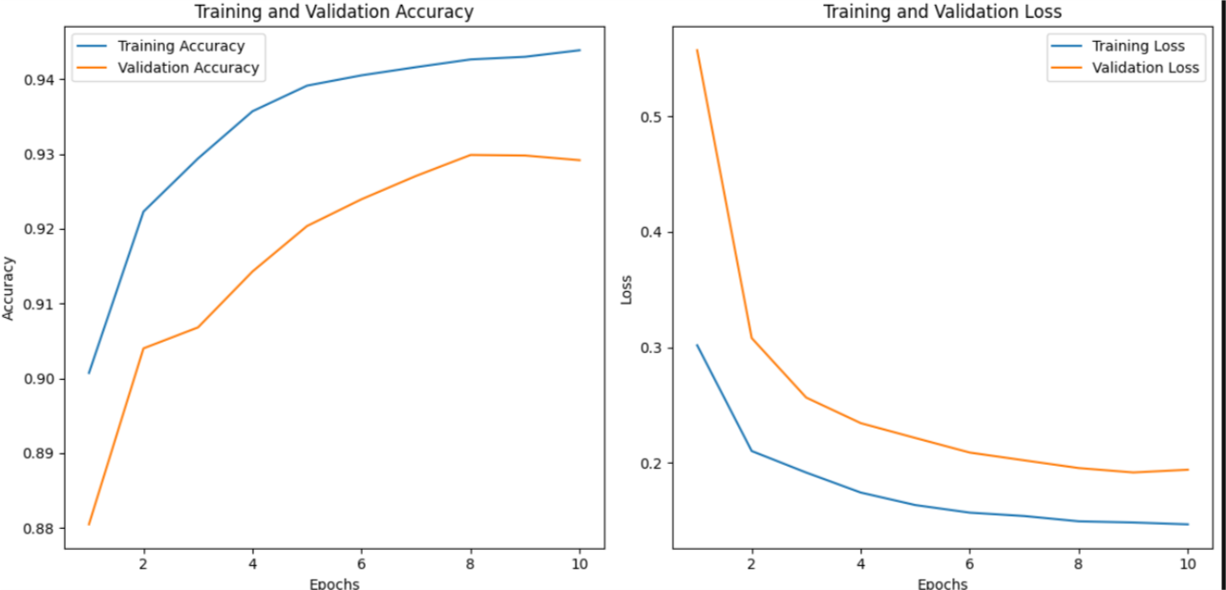
CROP 0 : LEGUME
ANALYSIS USING WEIGHTED-LSTM

Slide 47
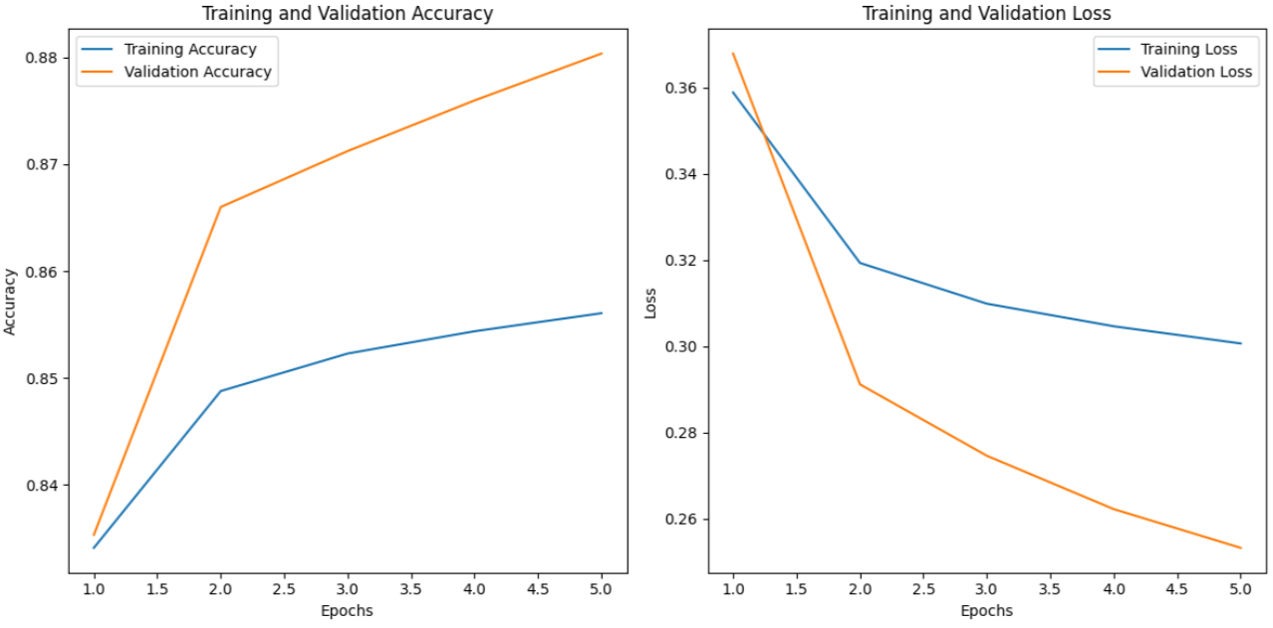
CROP 1 : GRASSLANDS
ANALYSIS USING WEIGHTED-LSTM

Slide 48
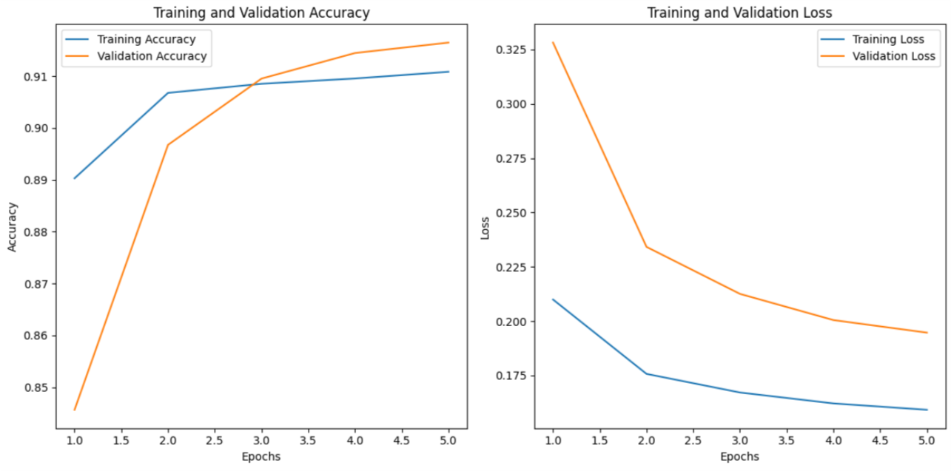
CROP 2 : MAIZE
ANALYSIS USING WEIGHTED-LSTM

Slide 49
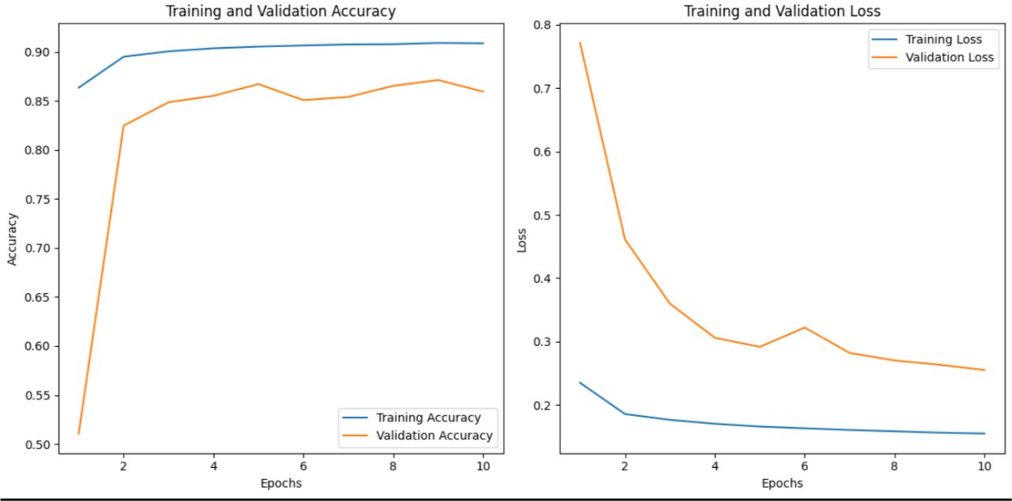
CROP 3 : POTATO
ANALYSIS USING WEIGHTED-LSTM

Slide 50
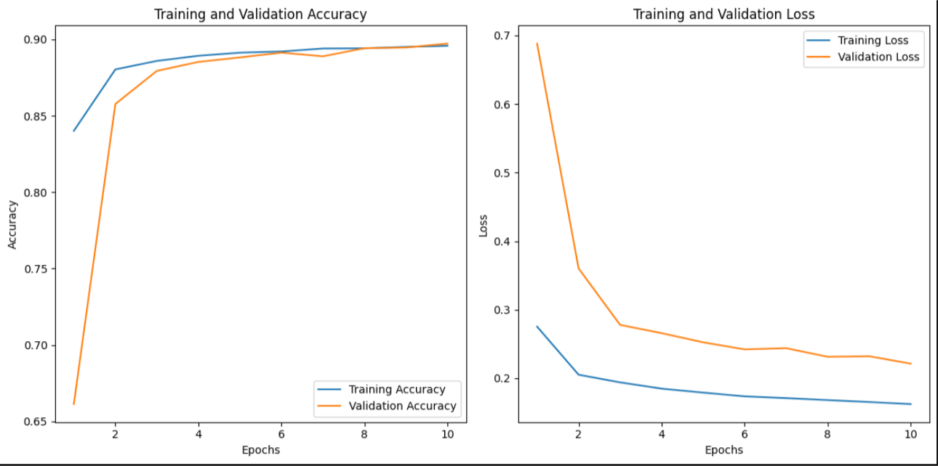
CROP 4 : SUNFLOWER
ANALYSIS USING WEIGHTED-LSTM

Slide 51
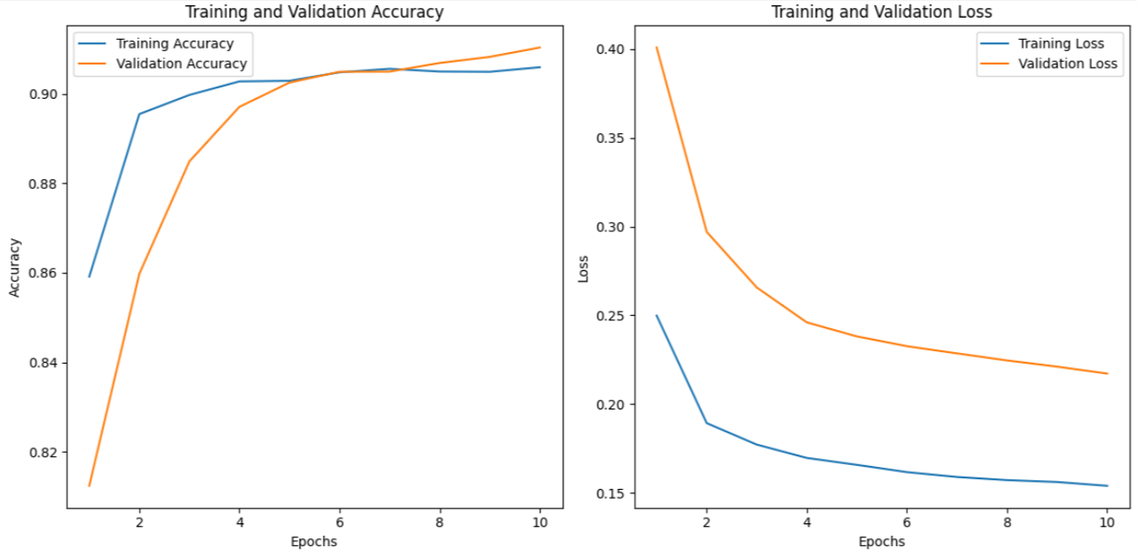
CROP 5 : SOY
ANALYSIS USING WEIGHTED-LSTM

Slide 52
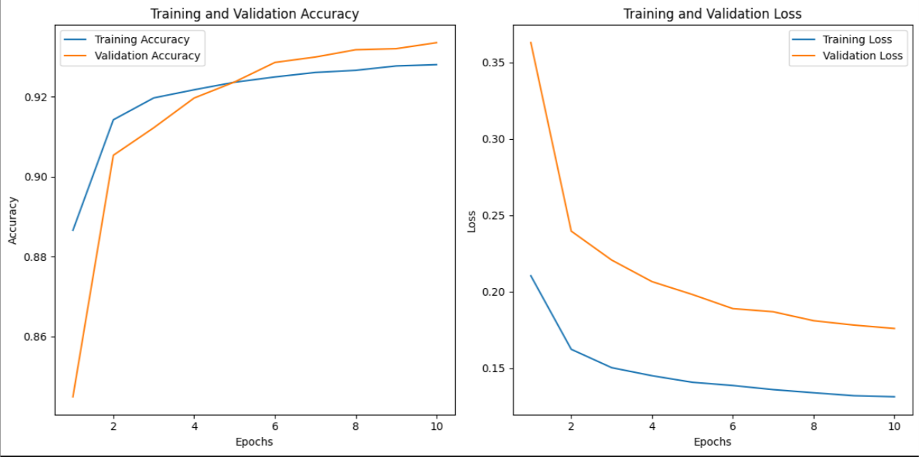
CROP 6 : WINTER BARLEY
ANALYSIS USING WEIGHTED-LSTM

Slide 53
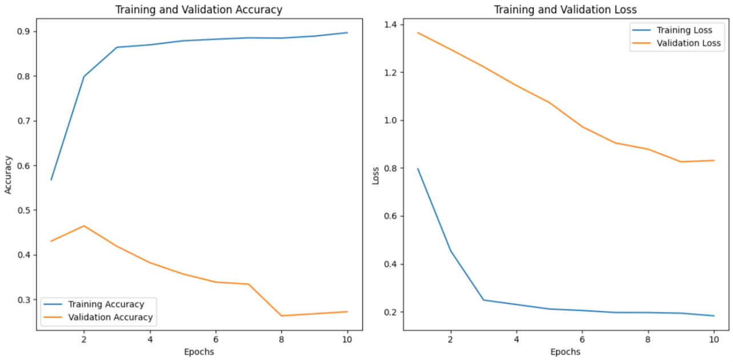
CROP 7 : WINTER CARAWAY
ANALYSIS USING WEIGHTED-LSTM

Slide 54
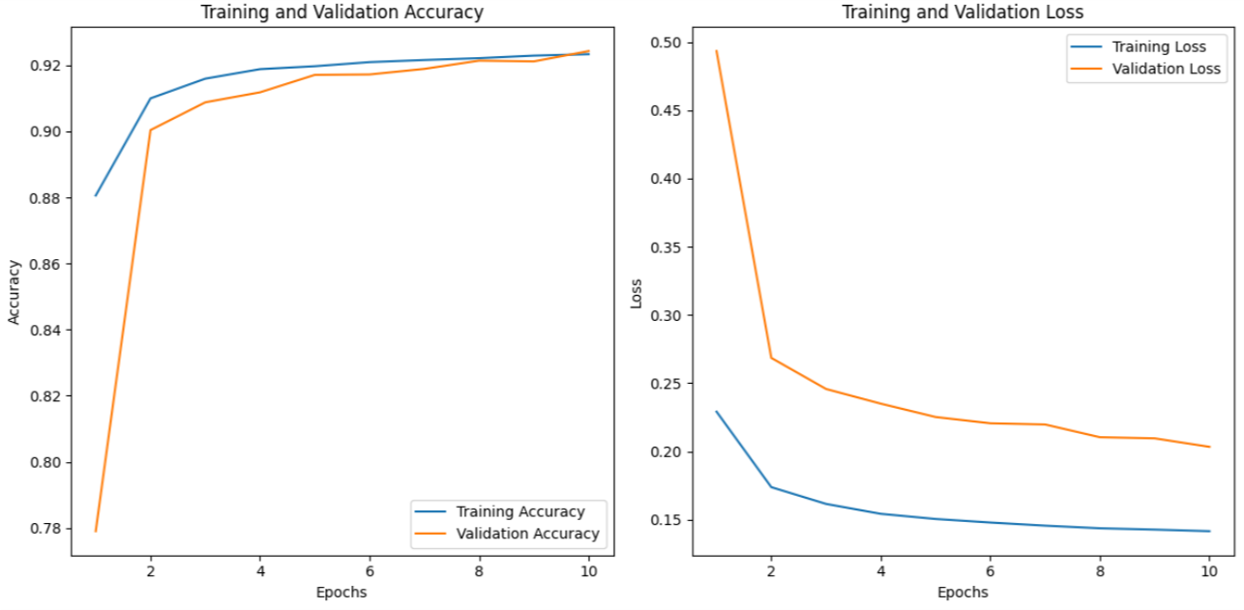
CROP 8 : RYE
ANALYSIS USING WEIGHTED-LSTM

Slide 55
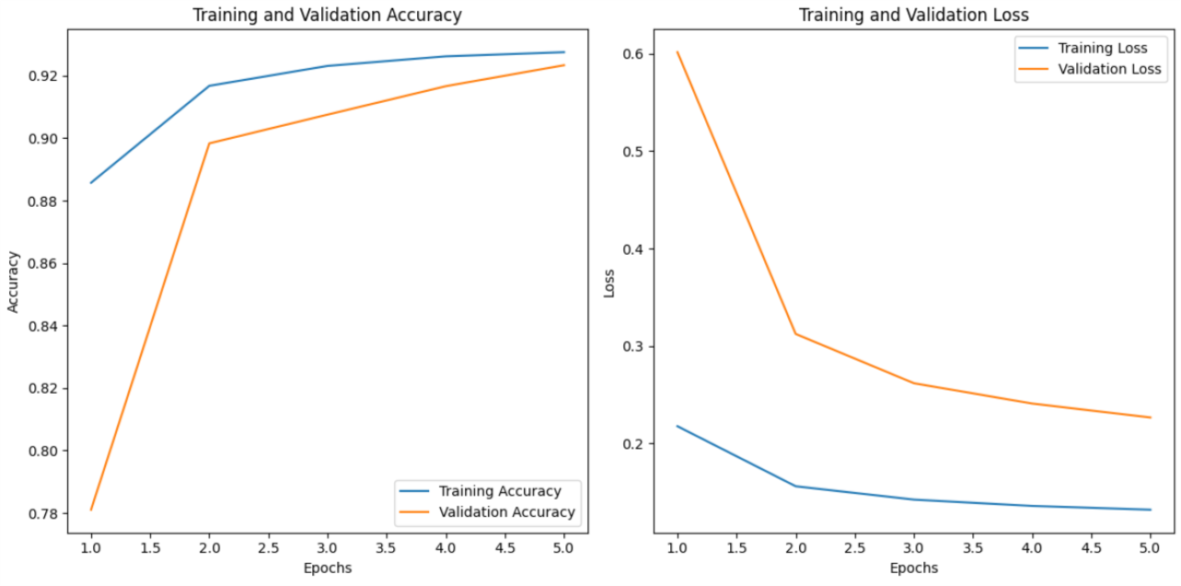
CROP 9 : RAPESEED
ANALYSIS USING WEIGHTED-LSTM

Slide 56
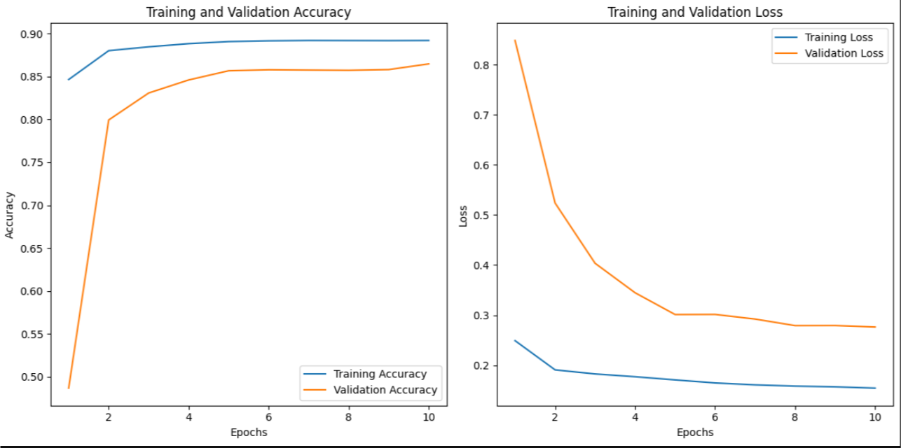
CROP 10 : BEET
ANALYSIS USING WEIGHTED-LSTM

Slide 57
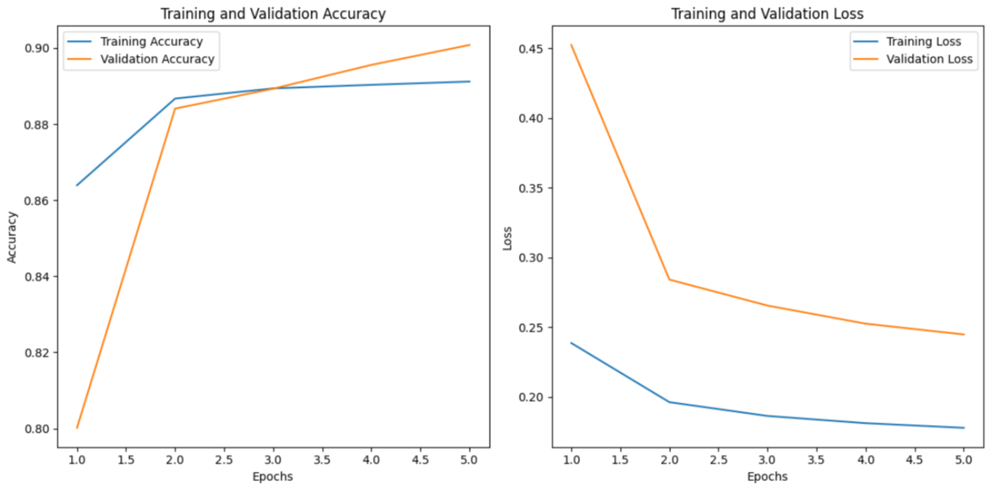
CROP 11 : SPRING BARLEY
ANALYSIS USING WEIGHTED-LSTM

Slide 58
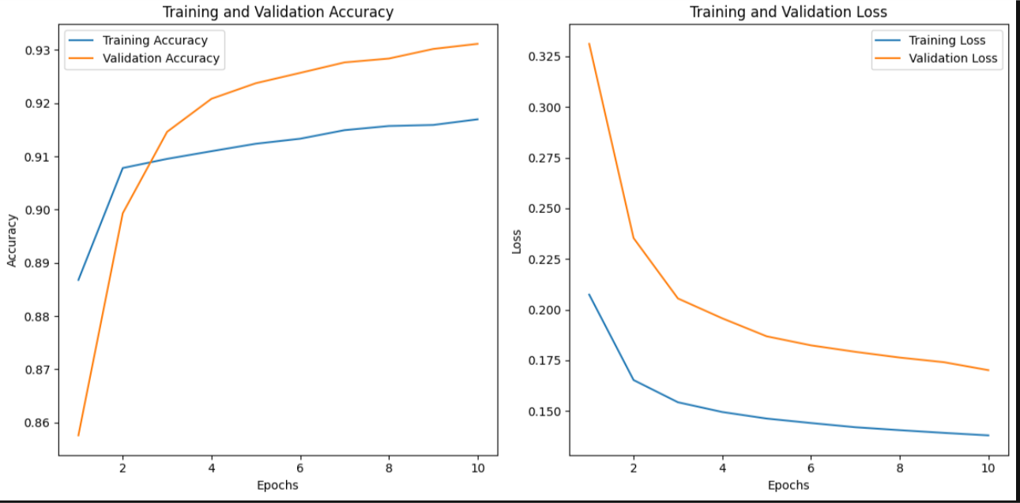
CROP 12 : WINTER WHEAT
ANALYSIS USING WEIGHTED-LSTM

Slide 59
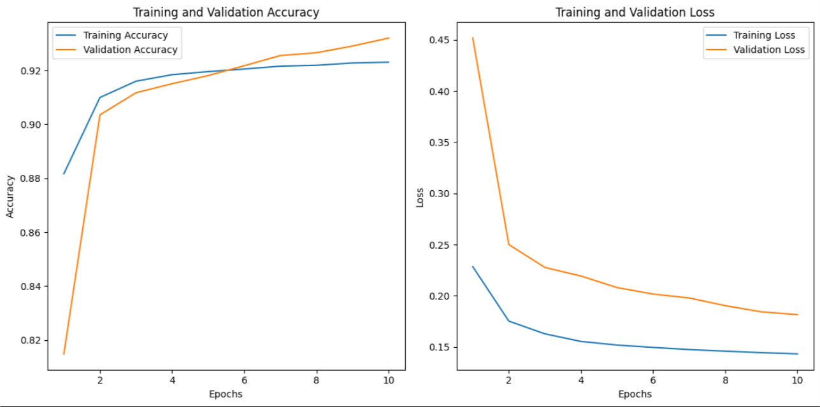
CROP 13 : WINTER TRITICALE
ANALYSIS USING WEIGHTED-LSTM

Slide 60
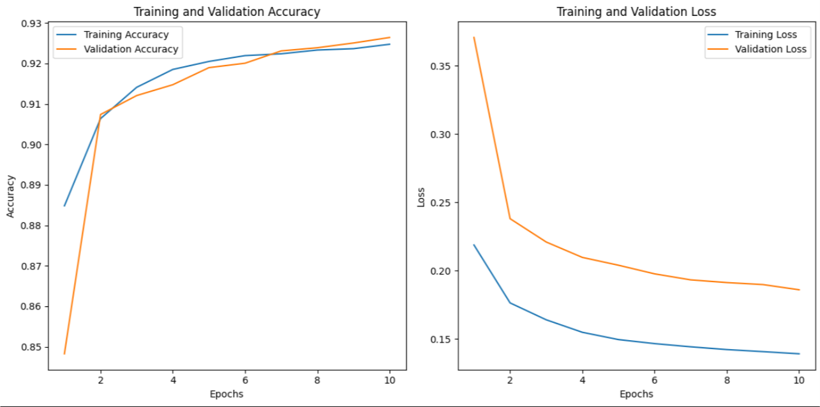
CROP 14 : PERMANENT PLANTATION
ANALYSIS USING WEIGHTED-LSTM

Slide 61
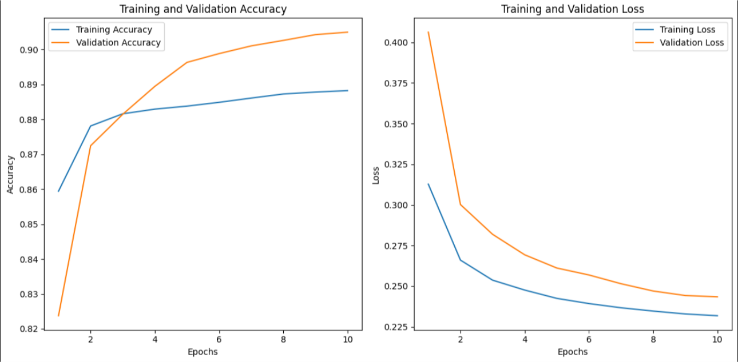
CROP 15 : OTHER CROPS
ANALYSIS USING WEIGHTED-LSTM

Slide 62
UpComing Next Checkpoint:
Trying for something more interesting over the complete Dataset using at least one Model completely (whichever is BEST) out of the selected 3 models to be implemented.
Boundary Classification

Slide 63
CS-540 ACPS PROJECT
CHECKPOINT—6

Slide 64
Progress Updated : 24 April
The remaining model i.e; Weighted LSTM also implemented fully with Results regarding Accuracy (%), Loss (%) and F1(%) score attached.
Comparison of all the Implemented models being also tabulated and attached.
Image Generation Task implemented .
Boundary classification task on one CNN model (partially completed ).

Slide 65
RESULTS (part–2)

Slide 66
RESULTS USING WEIGHTED LSTM

Slide 67
RESULTS Comparision
(3 Models)

Slide 69
GENERATED IMAGES

Slide 70

Crop [Tile-32TPT & Type-0] - Image
Attention-based Transformer model is used .

Slide 71
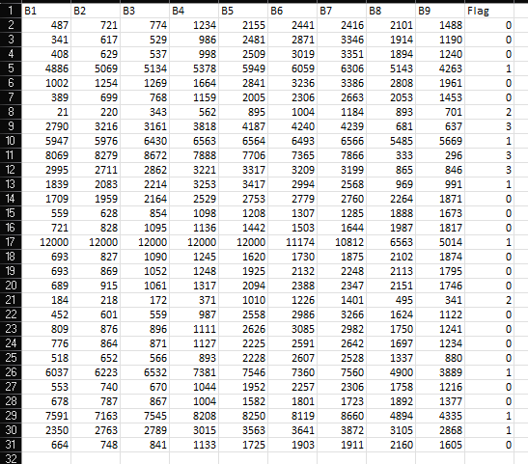
Crop [Tile-32TPT & Type-0] - Pixel CSV file

Slide 72
Crop [Tile-32TPT & Type-0] - CrossVerification

Slide 73
OBSERVATIONS
Reflectance value of a pixel captured across 9 spectral bands corresponds to light reflected by the surface at that pixel across various wavelengths.
Represented as grayscale intensity–
higher values = brighter pixels
lower values = darker pixels.
Each band corresponds to specific wavelengths capturing different surface characteristics.
Convert normalized values to grayscale intensity (0(Black)--255(White)).

Slide 74
BOUNDARY CLASSIFICATION RESPONSES

Slide 75
Models
1] For Boundary Classification, CNN Models required.
2] Models we implemented for Croptype Classification are Not Suitable
3] Among all CNN models, best ones are (Considering better performance over huge Dataset)-
a} EfficientNet (Agriculture based Data)
b} U-Net (Health Care based Data)

Slide 76
UpComing Next Checkpoint :
Completing Boundary Classification Task over EfficientNet CNN Model.
Completing Image Generation Task for one Model. (Transformer Model)

Slide 77
BOUNDARY CLASSIFICATION RESPONSES

Slide 78
Crop Type | Transformer |  |  | Temp CNN |  |  | Weighted LSTM
 | F1 SCORE(%) | LOSS(%) | ACCURACY(%) | F1 SCORE(%) | LOSS(%) | ACCURACY(%) | F1 SCORE(%) | LOSS(%) | ACCURACY(%)
Legumes | 94.27 | 17.51 | 93.75 | 95.87 | 12.07 | 95.36 | 94.94 | 13.88 | 94.6
Grassland | 91.84 | 21.02 | 92.13 | 92.98 | 18.97 | 92.79 | 93.03 | 18.52 | 92.87
Maize | 95.96 | 11.83 | 95.68 | 96.54 | 9.31 | 96.4 | 93.98 | 11.83 | 95.88
Potato | 92.98 | 19.26 | 93.07 | 95.31 | 13.21 | 94.97 | 92.98 | 19.26 | 93.07
Sunflower | 90.92 | 38.25 | 89.82 | 91.73 | 27.85 | 92.58 | 90.82 | 38.25 | 89.82
Soy | 96.02 | 11.72 | 95.77 | 96.83 | 8.47 | 96.71 | 96.49 | 9.6 | 96.34
Winter Barley | 95.68 | 11.36 | 95.71 | 96.48 | 9.18 | 96.33 | 96.34 | 9.78 | 96.12
Winter Caraway | 92.26 | 26.95 | 91.95 | 93.02 | 18.81 | 93.26 | 92.47 | 20.96 | 92.81
Rye | 92.66 | 19.25 | 92.98 | 94.46 | 15.13 | 94.21 | 94.25 | 16.35 | 93.85
Rapeseed | 95.79 | 14.04 | 94.97 | 96.52 | 9.98 | 96.27 | 96.15 | 10.90 | 95.87
Beet | 96.14 | 12.21 | 95.90 | 97.05 | 8.32 | 97.06 | 96.48 | 9.62 | 96.44
Sprint Cereals | 92.99 | 18.92 | 93.13 | 94.44 | 15.02 | 94.24 | 94.34 | 15.88 | 94.09
Winter Wheat | 95.97 | 10.81 | 95.89 | 96.7 | 8.32 | 96.7 | 96.61 | 9.13 | 96.33
Winter Triticale | 93.72 | 16.79 | 93.77 | 94.79 | 13.61 | 94.74 | 94.71 | 14.44 | 94.49
Permanent Plantation | 95.00 | 17.63 | 94.96 | 95.41 | 12.52 | 95.86 | 95.38 | 13.22 | 95.85
Other Crops | 93.21 | 18.57 | 93.39 | 94.61 | 14.96 | 94.3 | 94.06 | 15.91 | 94.07

Slide 79
CS-540 ACPS PROJECT
CHECKPOINT—7

Slide 80
RECAP….
Using time series sentil2 Dataset , crop type classification has been done through three models like Temp CNN, Transformer and weighted LSTM.
Performance metrics and performance plots for each of the model has also been shown.

Slide 81
VEGETATION MONITORING
Vegetation Monitoring over period of 1 year has been conducted.
From the dataset,red and near infrared reflectance band values are
obtained and used in NDVI calculation.
Changes in NDVI values of each crop in every location of Austria has been calculated and plotted.

Slide 82
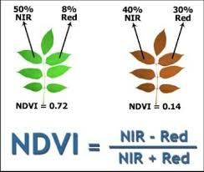
NDVI CALCULATION
Dataset consists of various spectral band reflectance from B2 to B12 like blue, green, red etc.
RED is given by B4 band
Near IR is given by B8 band

Slide 83
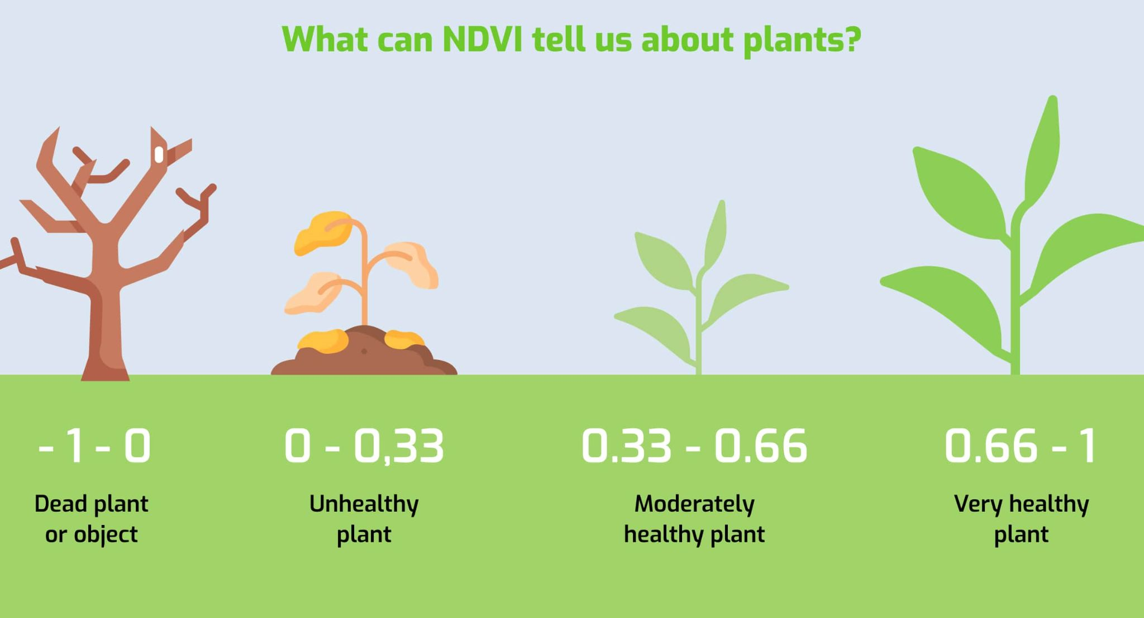
Normalized Difference Vegetation Index

Slide 84
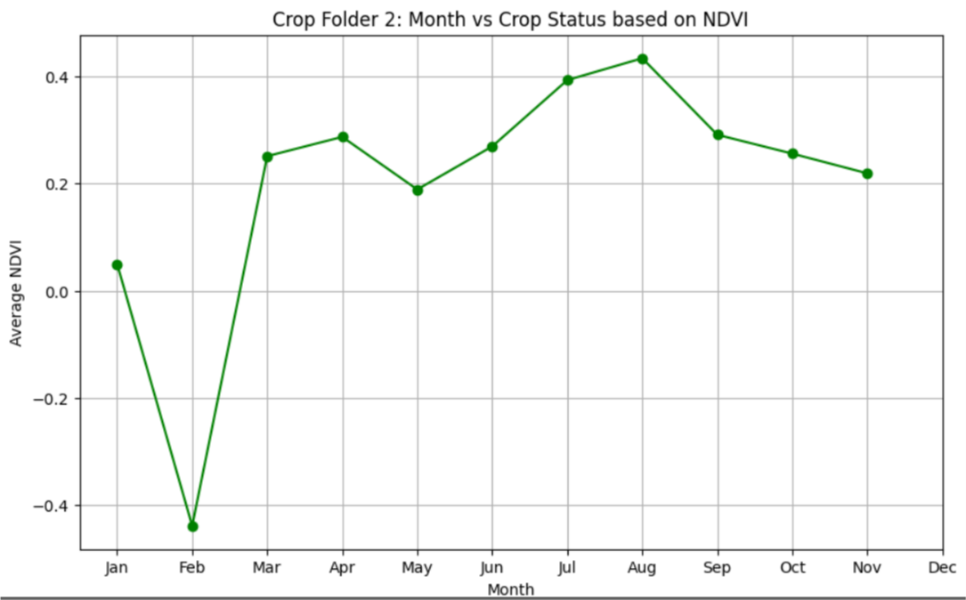
Sample Output of Crop NDVI Variation
Moderately Healthy Crop
Disease Affected Crop
Area Covered withwater

Slide 85
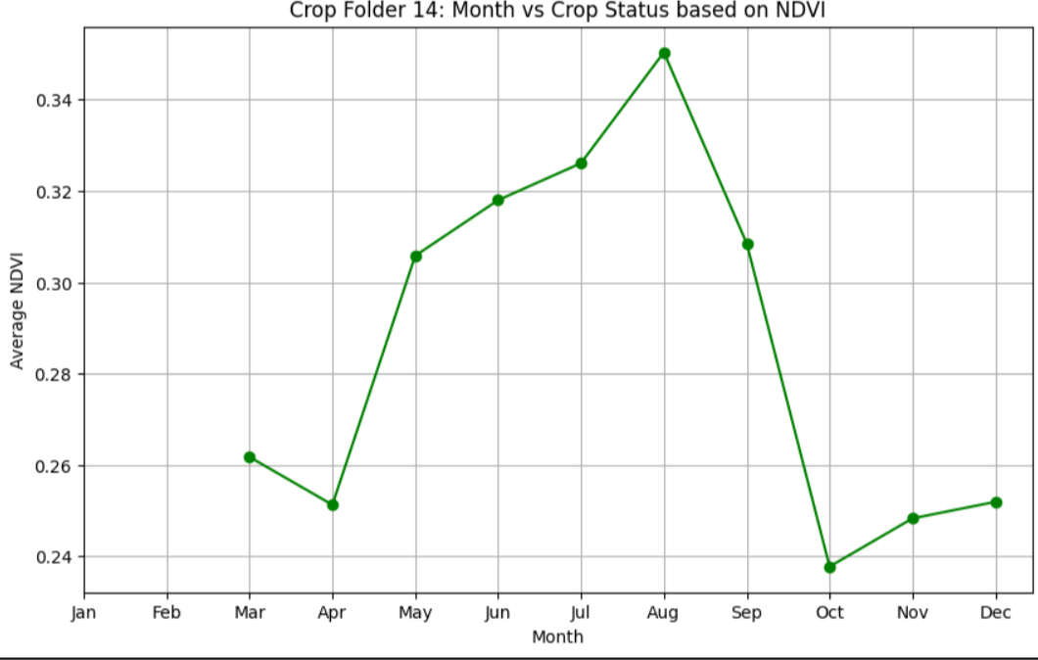
Sample Output of Crop NDVI Variation

Slide 86
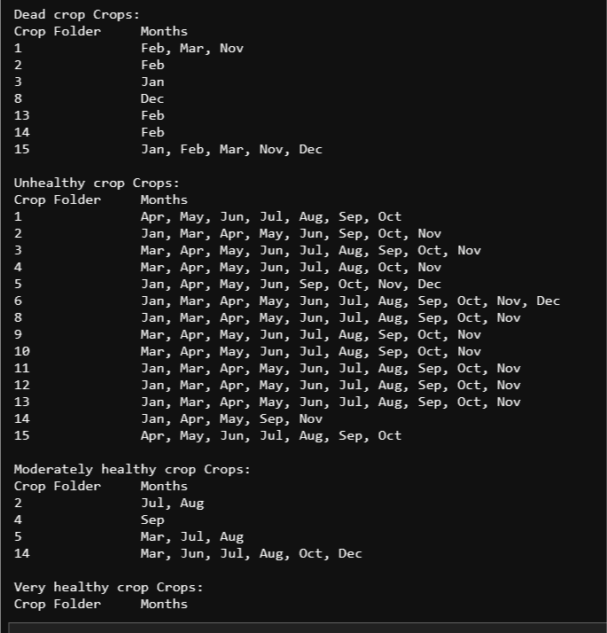
Growth Stages of Various Crops in a particular area of Austria

Slide 87
CONCLUSION
The following inferences were obtained:
1. Crop type mapping has been analyzed using three supervised models.
2. Training Accuracy vs Validation Accuracy, Training Loss vs Validation Loss curves were plotted to visualize in-depth.
3. By map type mapping in a particular area,boundary classification task has also been accomplished.
4. The Crop growth for almost 1-year was analysed using NDVI spectral index.
5. Through the analysis plant health,optimum location suitable for growth of crops,harvesting time of crops etc can be found out.

Slide 88


